Slide 1
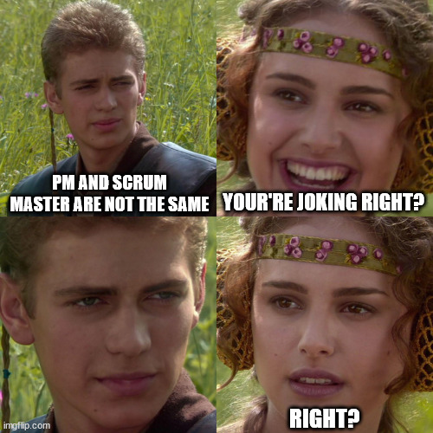

Project Manager vs Scrum Master

Slide 2


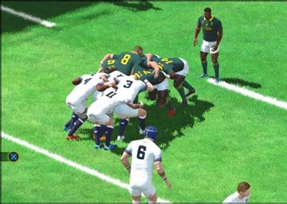

Why is it important to talk about them?

